Slide 1

Kinect Dev – Patient Contact Detection System & Medical Equipment Detection System
Junyang Chen

Slide 2
First Part: Patient Contact Detection System

Slide 3
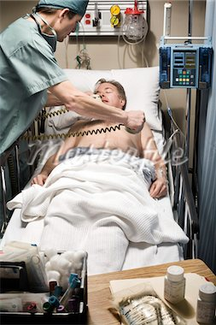
Goal
To build a Kinect application that can detect and record the contacts healthcare workers made to patients in medical room

Slide 4
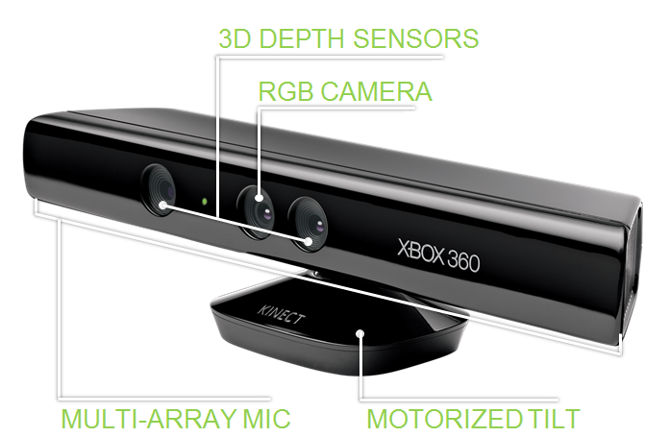
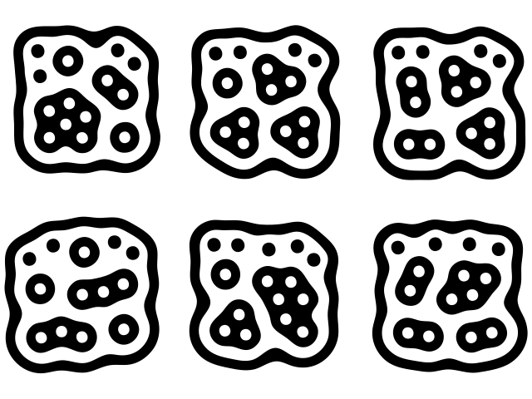
Tools
Kinect
Microsoft Kinect for Windows SDK
Visual studio 2012
C#
ReacTIVision library
Much more accurate and stable than the OpenCV library
No need to worry about color fluctuation
Fiducial Markers

Slide 5
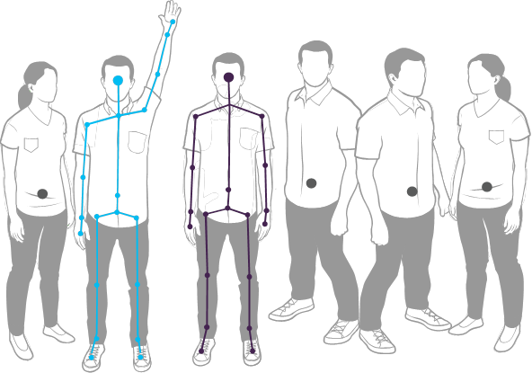
Skeletal Tracking
Can track up to 6 people, 2 of them with 20 full skeleton joints

Slide 6
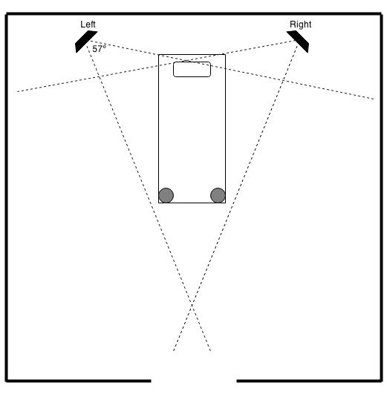
Setting
Place two Kinects at the opposite sides of the bed
Attach two fiducial markers at the end of the bed
Detect the positions of two markers
Knowing normal vector of the floor from the accelerometer in Kinect, compute and create the 3D detection box
Update constantly

Slide 7
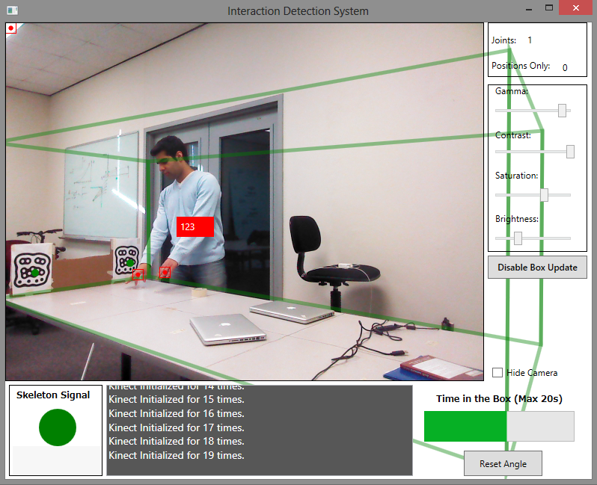
System UI

Slide 8
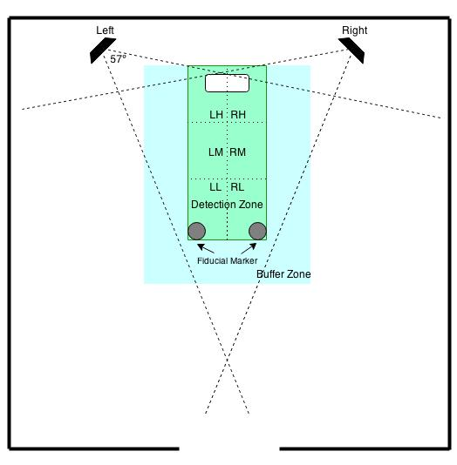
Functionality
Each Kinect tracks the opposite side
Detection Zone (3D box)
Hand tracking
Can track hands of up to two people each side simultaneously
Buffer Zone
2 first-in people will be tracked fully
4 people will be tracked with position-only
Pick up people intelligently
Stick with fully-tracked people until they leave
Divide the bed into 6 sub-regions (LH, RH, LM, RM, LL, RL)

Slide 9
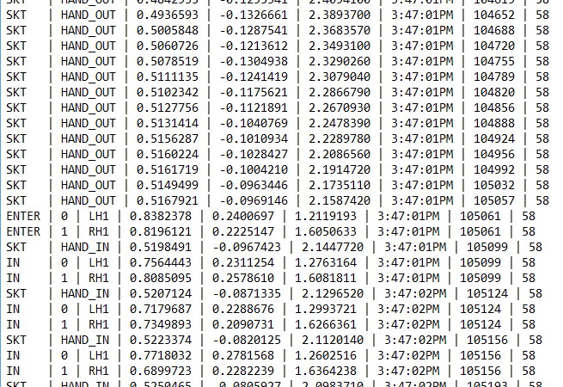
Collected Data
Buffer Zone
Detection Zone

Slide 10
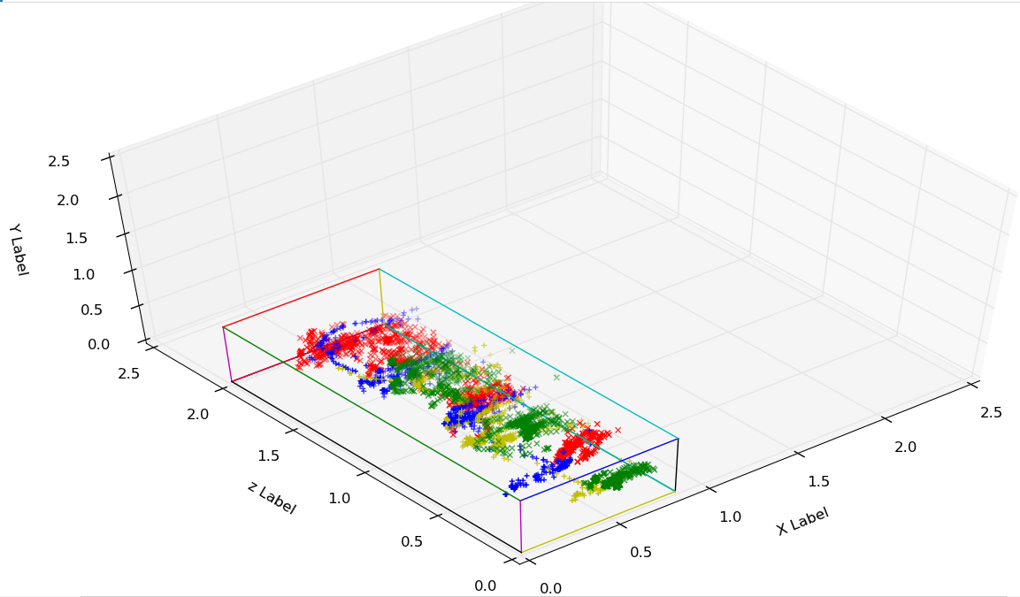
Data Visualization
Head of Bed
Captured by Left Kinect
Green: Left Hand 1
Red: Right Hand 1
Yellow: Left Hand 2
Blue: Right Hand 2

Slide 11
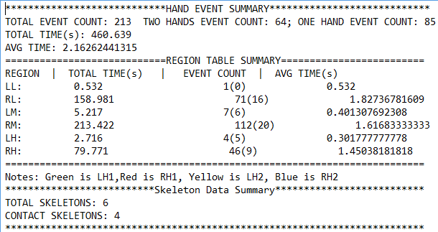
Data Analysis

Slide 12
Results
Scenario 1: one person, both sides of bed, 60 seconds, 22 touches.
Scenario 2: one person, one side of bed, 270 seconds, 97 touches.
Scenario 3: three people, both sides of bed, 135 seconds, 68 touches.
Scenario 4: two people, both sides of bed, 480 seconds, 181 touches.
 | Detected as touch but substantially erroneous (more than 2s erroneous data | Detected as touch with partially inaccurate (less than 2s erroneous data) | Detected accurately (accurate start/stop times and trajectory)
Touch event | 0 | 33 | 332
No touch | 5 | 0 | many/infinite

Slide 13
Second Part: Medical Equipment Detection System

Slide 14
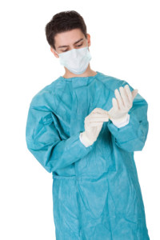
Goal
To build a Kinect application that can detect if a healthcare worker is wearing certain kinds of medical equipment when he/she entering medical room
?

Slide 15
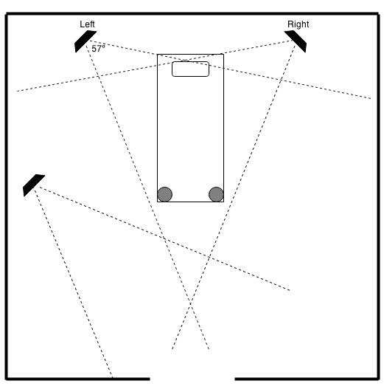
Setting
One Kinect pointing to the door with the distance of about 3.5 meters

Slide 16
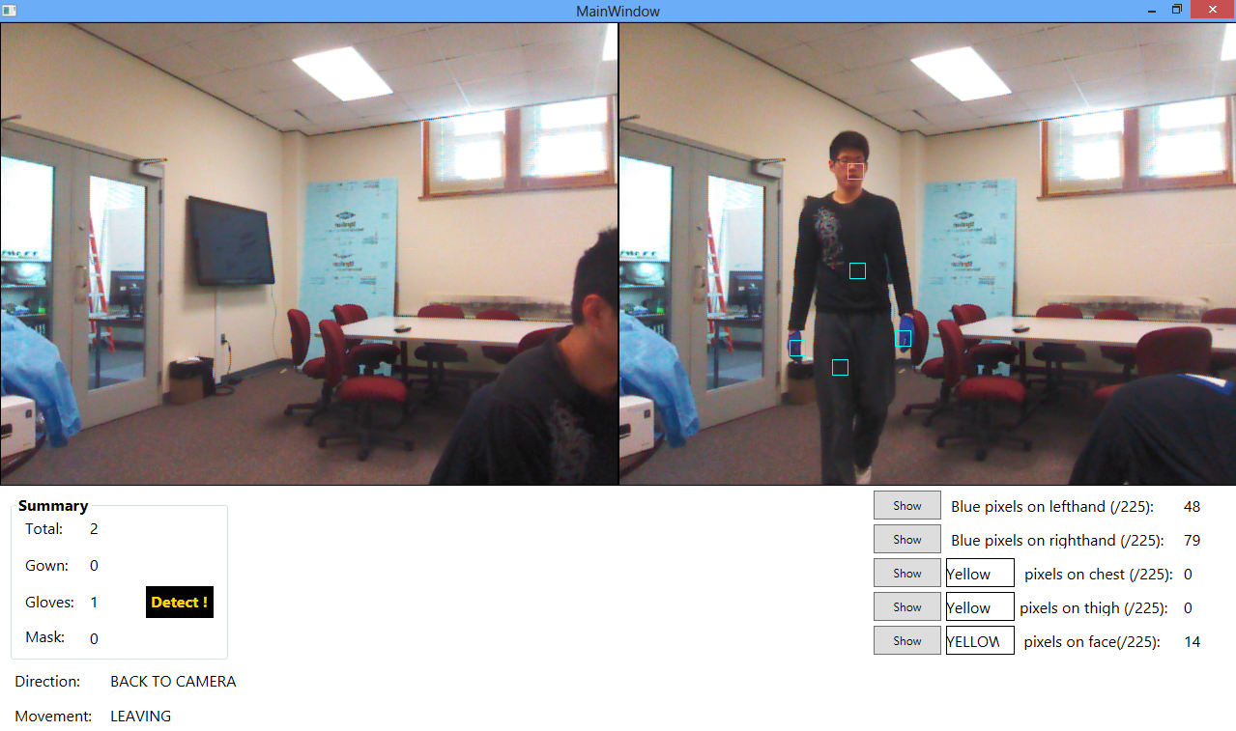
System UI

Slide 17
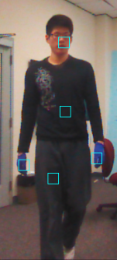

Approach
Use skeletal tracking to locate specific parts of body (thigh, chest etc.)
Use short-term position history to determine if individual is moving in/out of room
Color feature extraction
Sample 15 X 15 pixel region for each position
Measure the relativity of the RGB values in each pixel
Classify found/not found by comparing statistical summary of colors with expected colors
Currently not very robust for light colors

Slide 18
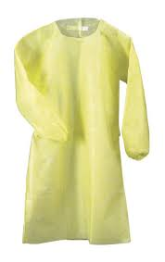
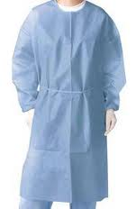
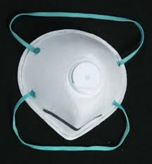
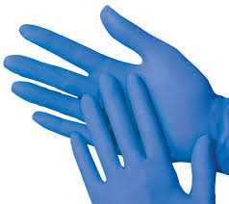

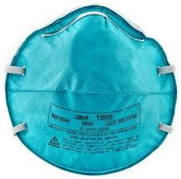
Functionality
One person at a time
Only consider people who are entering the room
Supported medical equipment:

Slide 19
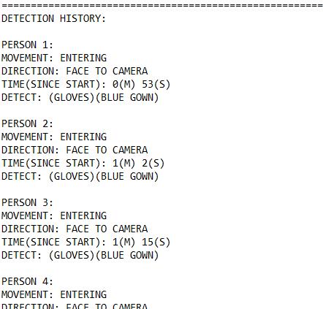

Collected Data
At the end

Slide 20
Results
Gown | Not detected | Detected
Worn | 0 | 62
Not worn | 53 | 1
Gloves | Not detected | Detected
Worn | 8 | 50
Not worn | 57 | 1
Sensitivity: 100.0% Specificity: 98.15%
Sensitivity: 86.21% Specificity: 98.28%
Mask | Not detected | Detected
Worn | 0 | 36
Not worn | 79 | 1
Sensitivity: 100.0% Specificity: 98.75%.

Slide 21
Thank You

